Slide 1
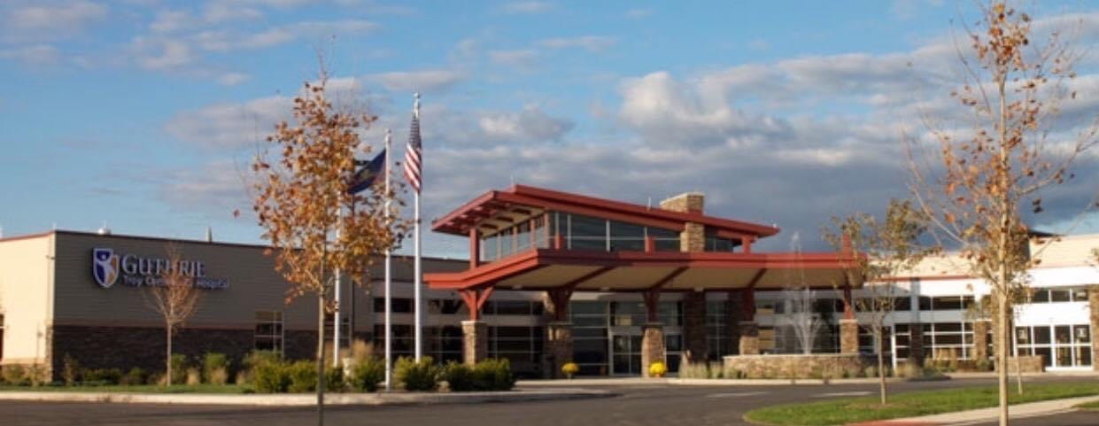
Guthrie Troy Community Hospital
Lori Barnett, RN, MSN
SVP, President/COO
Lori.Barnett@Guthrie.org
570-297-9253

Slide 2
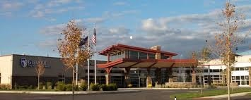
Mission
Guthrie works with the communities we serve to help each person attain optimal, life-long health and well-being. We will do so by providing integrated, clinically-advanced services that prevent, diagnose, and treat disease, within an environment of compassion, learning, and discovery.
Vision
Improving Health through Clinical Excellence and Compassion; Every Patient. Every Time.
Values
Patient-Centeredness
Teamwork
Excellence

Slide 3

Guthrie Troy Community Hospital Board of Trustees
KENNETH R. LEVITZKY, ESQUIRE
MEADE MURTLAND
Chairman
Residence: Sayre, PA
Residence: Laporte, PA
JERRY CARR
RICHARD ROBINSON
Residence: Spencer, NY
Residence: New Albany, PA
LORI BARNETT
PAUL VERVALIN
Residence: Mansfield, PA
Residence: Elmira, NY
VANCE A. GOOD, M.D.
DENISE IVES
Residence: Troy, PA
Residence: Troy , PA
EDWARD JONES, M.D.
JOHN ESTEP
Residence: Athens, PA
Residence: Troy, PA
JANET LEWIS
JEFFERY JENKINS
Secretary/Treasurer
Residence: Towanda, PA
Residence: Endicott, NY
JANEEN SHEHEE
Residence: Troy, PA

Slide 4
Critical Access Hospital
- Must meet the CMS requirements for CAH
* Designated by the State
* Located in a rural area
* Located 35 miles from nearest Hospital or CAH, or more than 15 miles with mountainous
terrain/secondary roads, OR prior to Jan 1, 2006, certified as a “necessary provider”
* No more than 25 inpatient beds (used for either inpatient or swing-bed services)
* Maintain an annual average length of stay of 96 hours or less per patient for acute inpatient
*Comply with the CAH CoPs 42 CFR Part 485 (F)
* Furnish 24-hour emergency care 7 days/week
- A networking partner is required
* TCH networks with Robert Packer Hospital
- Assists with Performance Improvement initiatives, accepts patient transfers for higher level of care

Slide 5

Constructed in 2013 Guthrie Troy Community Hospital includes…
25 Private Rooms: Large natural light windows, relaxing atmosphere, decreased traffic, activity department
7 bay Emergency Department with 2 bay trauma, Helipad
2 Large Operating Rooms with 7 bed Pre and Post Operating care unit.
Outpatient Services include:
- Radiology: CT, MRI, Mammography, Bone Density, Ultrasound, Diagnostics
- Lab Services
- Rehab: Physical Therapy, Occupational Therapy, Speech, Cardiac Rehab
- Cardiovascular Diagnostics: Stress Testing, EKG, TEE (Trans Esophageal Echo), Cardioversion, Echo
- Respiratory Therapies: Sleep lab, PFT’s (Pulmonary Function Testing)

Slide 6
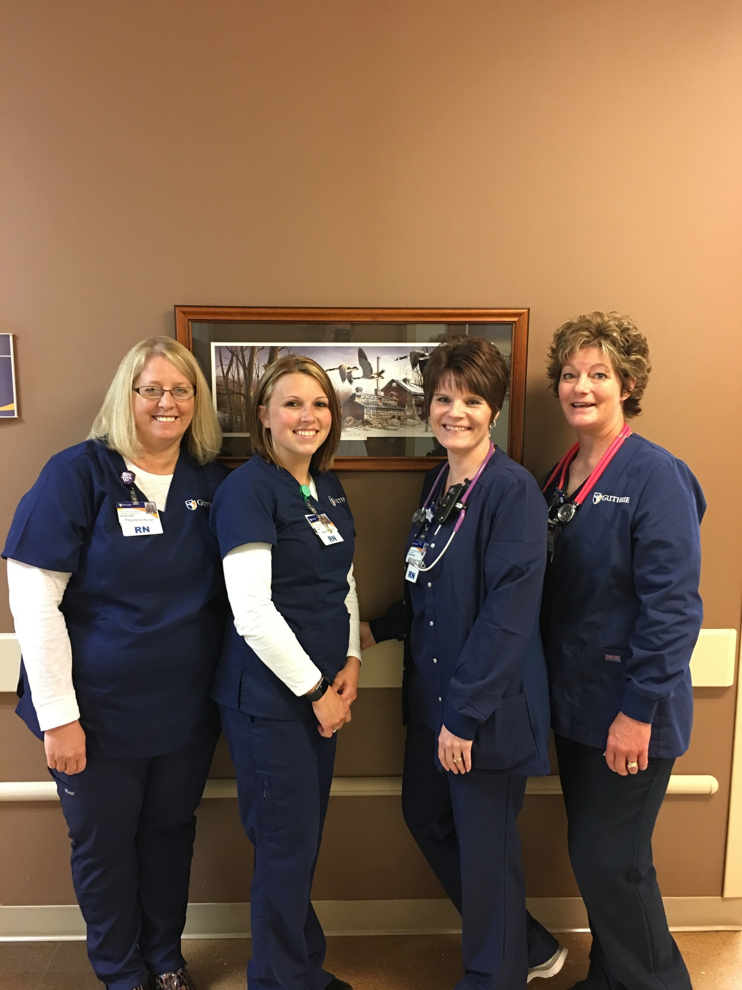
Acute admissions
Swing bed/subacute
Ventilator Weaning Program
- 25 Private Rooms
- 2 Negative Pressure Rooms
- 4 Ceiling lifts
- Accommodations for family/visitors overnight
- Improvements in patient safety; medication cupboards, computers in rooms, bar code scanning
- Telemetry Services
Hospitalist Approach
- Dr. Paulish, Dr. Houssana, Diana Robbins NP, Elizabeth Hotaling NP
- Cardiology; Dr. Subrayappa
Inpatient Services

Slide 7
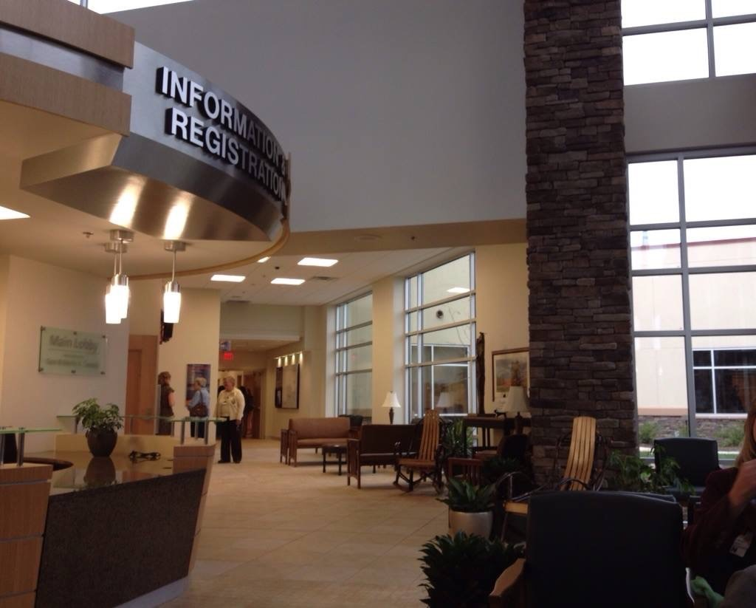
Outpatient Services
Surgical Services
  Pain Management – Dr. Lockard
  GI Procedures – The Guthrie Clinic GI team; Dr. Pfisterer, Dr. Merchant and Dr. Chalabi, Dr. Ferenzi
  General Surgery – Dr. Chalabi, and Dr. Merchant
  Podiatric surgery - Dr. Elise Nelson, Dr. Kilpatrick
Lab Services
Respiratory
24/48 hour Holter monitor
Home sleep studies
EKG’s
Sleep Studies
Scheduled 3-4 times /week
Nocturnal polysomnogram (sleep studies), PFT (Pulmonary Function Test), CPAP titration and other
tests for sleep apnea

Slide 8
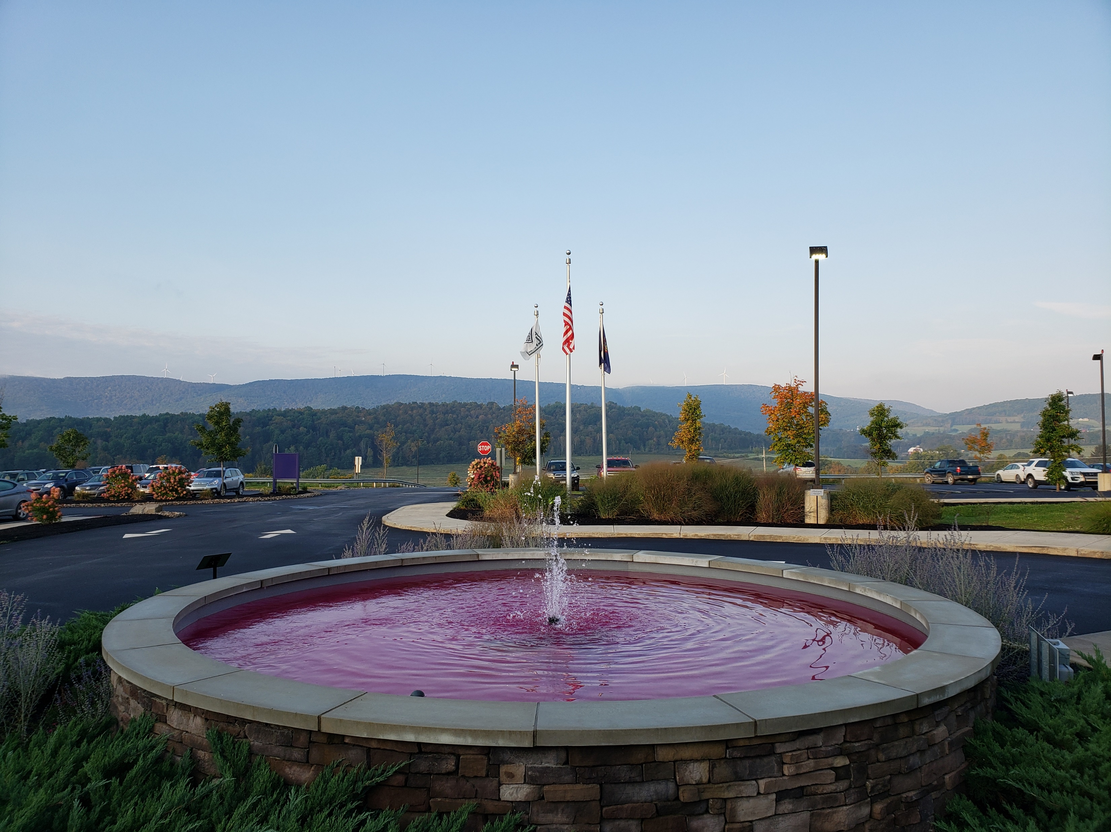
Radiology Services
  Late and early hour appointments, as well as Saturday
  Staff “in house” 24/7 for CT and x-ray
  64 slice CT scanner
  3D Mammography equipment
  MRI with canopy allows for inpatient scans
    Appointments available 2-3 days per week

Slide 9
Rehab Services
Guthrie Troy Community Hospital offers both inpatient and outpatient services for Physical Therapy, Speech Therapy and Occupational Therapy.
Cardiac Rehab is offered on as outpatient service

Slide 10

Emergency Department Trauma Level IV
Trauma IV Certification – Surveyed August 11, 2021
- 2-year accreditation
- First CAH in Pa to receive Trauma certification
Education
- Rural Trauma Team Development Course (RTTDC)
- Advance Trauma Care for Nurses (ATCN)
- Trauma Nurse Core Course (TNCC)

Slide 11
Quality
Trauma IV Certification
Pa Dept. of Health - Biannually
Healthcare Facilities Accreditation Program (HFAP) – Triennially
Mammography, CT, Ultrasound and MRI are accredited by the American College of Radiology every 3 years
Cardiac Rehab is accredited by the American Association of Cardiovascular and Pulmonary Rehabilitation every three years.
Measure metrics monthly/daily – Readmissions, Falls, Mortality, Patient experience, Sepsis protocols, Trauma PI.

Slide 12
In The Community
Active Member of Troy and Mansfield Area Chamber of Commerce
Refreshments and Staff provided at Troy Town Cruisers
Provide meeting space for local clubs and groups (Troy Booster Club, Ham Radio group)
Host high school service-learning program. Junior and Seniors seeking Healthcare related career
Breast Cancer awareness community education
.

Slide 13
Community Needs Assessment
Under the Patient Protection Affordable Care Act (PPACA), every 501(c)(3) hospital is required to satisfy requirements to maintain tax exempt status. Each state-licensed hospital facility must create a Community Needs Health Assessment (CHNA) at least once every three taxable years
FY 22 Identified Community Health Needs TCH plans to address include:
Access to Mental Health Care (focus: substance abuse)
- Collaboration with CASA trinity
- Provider education for opiate prescribing and management
- Improve discharge planning process to increase patient access to substance abuse resources
Cancer Incidence - lung
- Promote health and wellness of employees, patients, and communities through
tobacco cessation.
- Promote the importance of lung cancer screening and treatment
Obesity
- Community Garden provided by Guthrie (Sayre)
- Guthrie continued partnership with GoNoodle

Slide 14
COVID
Masks required
Social distancing
Proper hand hygiene
Negative pressure rooms for positive patients
Surge plan in place

