Slide 1
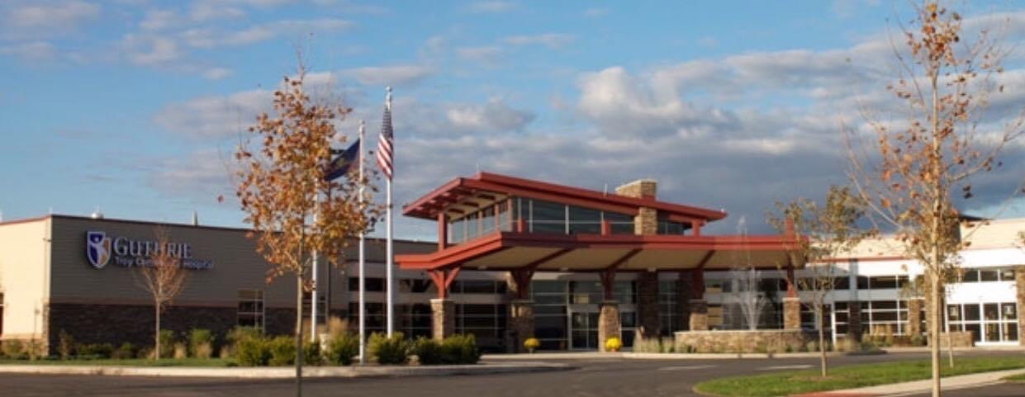
Guthrie Troy Community Hospital
Lori Barnett, RN, MSN
SVP, President/COO
Lori.Barnett@Guthrie.org
570-297-9253

Slide 2
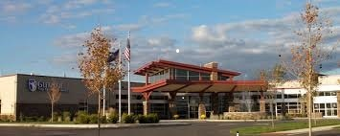
Mission
Guthrie works with the communities we serve to help each person attain optimal, life-long health and well-being. We will do so by providing integrated, clinically-advanced services that prevent, diagnose, and treat disease, within an environment of compassion, learning, and discovery.
Vision
Improving Health through Clinical Excellence and Compassion; Every Patient. Every Time.
Values
Patient-Centeredness
Teamwork
Excellence

Slide 3

Guthrie Troy Community Hospital Board of Trustees
KENNETH R. LEVITZKY, ESQUIRE
CATHERINE MOHR
Chairman
Residence: Sayre, PA
Residence: Laporte, PA
MEADE MURTLAND
JERRY CARR
Residence: Sayre, PA
Residence: Spencer, NY
RICHARD ROBINSON
LORI BARNETT
Residence: New Albany, PA
Residence: Troy, PA
PAUL VERVALIN
VANCE A. GOOD, M.D.
Residence: Elmira, NY
Residence: Troy, PA
DENISE IVES
EDWARD JONES, M.D.
Residence: Troy , PA
Residence: Athens, PA
WILLIAM FARLEY
JANET LEWIS
Residence: Towanda, PA
Secretary/Treasurer
Residence: Towanda, PA
JOHN ESTEP
JANEEN SHEHEE
Residence: Troy, PA
Residence: Troy, PA
JEFFERY JENKINS
Residence: Endicott, NY

Slide 4
Critical Access Hospital
- Must meet the CMS requirements for CAH
* Designated by the State
* Located in a rural area
* Located 35 miles from nearest Hospital or CAH, or more than 15 miles with mountainous
terrain/secondary roads, OR prior to Jan 1, 2006, certified as a “necessary provider”
* No more than 25 inpatient beds (used for either inpatient or swing-bed services)
* Maintain an annual average length of stay of 96 hours or less per patient for acute inpatient
*Comply with the CAH Conditions of Participation 42 Code of Federal Regulations Part 485 (F)
* Furnish 24-hour emergency care 7 days/week
- A networking partner is required
* TCH networks with Robert Packer Hospital
- Assists with Performance Improvement initiatives
- accepts patient transfers for higher level of care

Slide 5
Constructed in 2013 Guthrie Troy Community Hospital includes…
25 Private Rooms: Large natural light windows, relaxing atmosphere, decreased traffic, activity department
7 bay Emergency Department with 2 bay trauma, Helipad
2 Large Operating Rooms with 7 bed Pre and Post Operating care unit.
Radiology: CT, MRI, Mammography, Bone Density, Ultrasound, Diagnostic X-ray, Ultrasound breast biopsies.
Lab Services: including COVID testing
Rehab: Physical Therapy, Occupational Therapy, Speech, Cardiac Rehab
Cardiovascular Diagnostics: Stress Testing, Holter monitoring, EKG, TEE (Trans Esophageal Echo), Cardioversion, ECHO
Respiratory Therapy: Sleep studies including overnights and home studies, PFT’s (Pulmonary Function Testing) and Oximetry testing

Slide 6
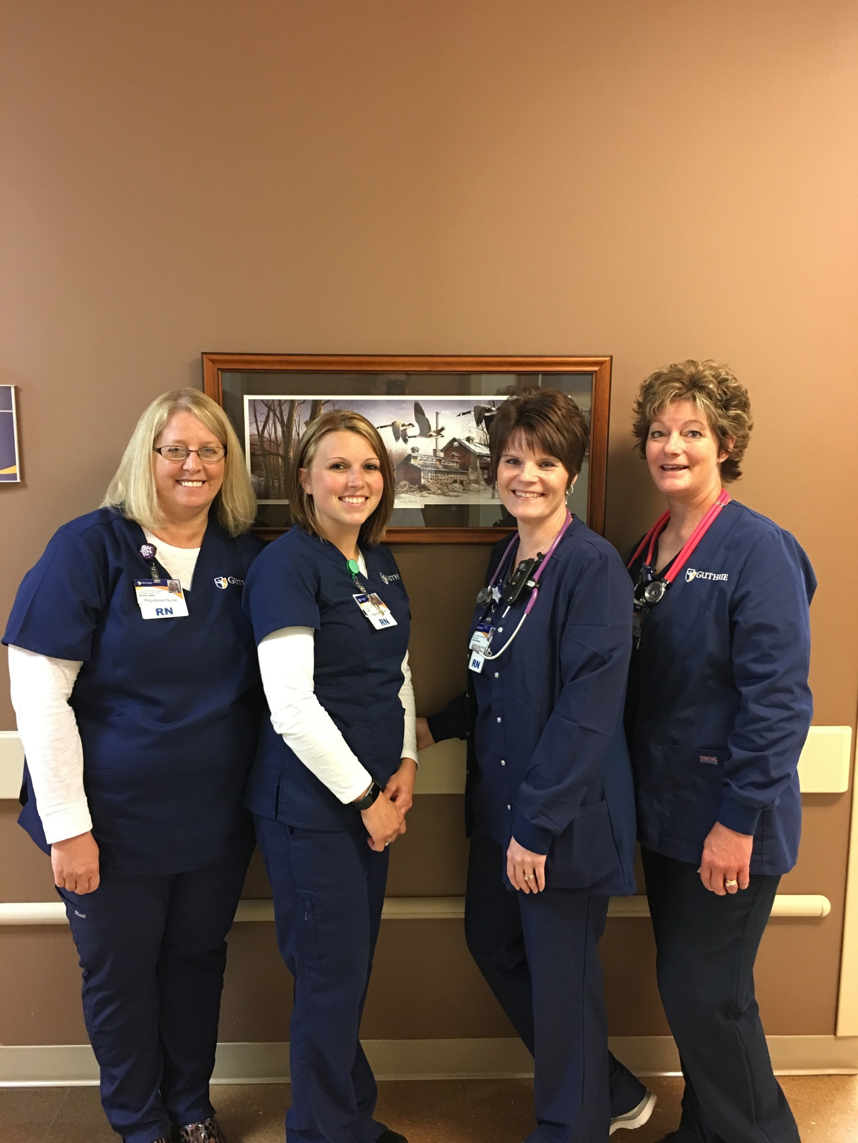
Acute admissions
Swing bed/subacute
Ventilator Weaning Program
- 25 Private Rooms
- 2 Negative Pressure Rooms
- 4 Ceiling lifts
- Accommodations for family/visitors overnight
- Improvements in patient safety; medication cupboards, computers in rooms, bar code scanning
- Telemetry Services
Hospitalist Approach
- Dr. Paulish, Dr. Houssana, Diana Robbins NP, Mary Cotton NP, Caryn Henderson NP
Cardiology
- Dr. Subrayappa
Inpatient Services

Slide 7
Outpatient Services
Surgical Services
  Pain Management – Dr. Lockard
  GI Procedures – The Guthrie Clinic GI team; Dr. Pfisterer, Dr. Merchant and Dr. Chalabi
  General Surgery – Dr. Chalabi, Dr. Ferenzi and Dr. Merchant
  Podiatric surgery - Dr. Nelson and Dr. Kilpatrick
Sleep Services
  Scheduled 3-4 days per week
  Offer nocturnal polysomnogram (sleep studies), CPAP titration, Split studies, Home sleep studies and nocturnal oximetry.
  Pulmonary Function Testing
  Offered 5 days per week
  Including spirometry, spirometry with bronchodilation, bronchial provocation, diffusing capacity,
  Maximum Inspiratory Pressure(MIP), Maximum Expiratory Pressure (MEP), and Arterial Blood Gases
Lab Services:
Offered seven days per week

Slide 8
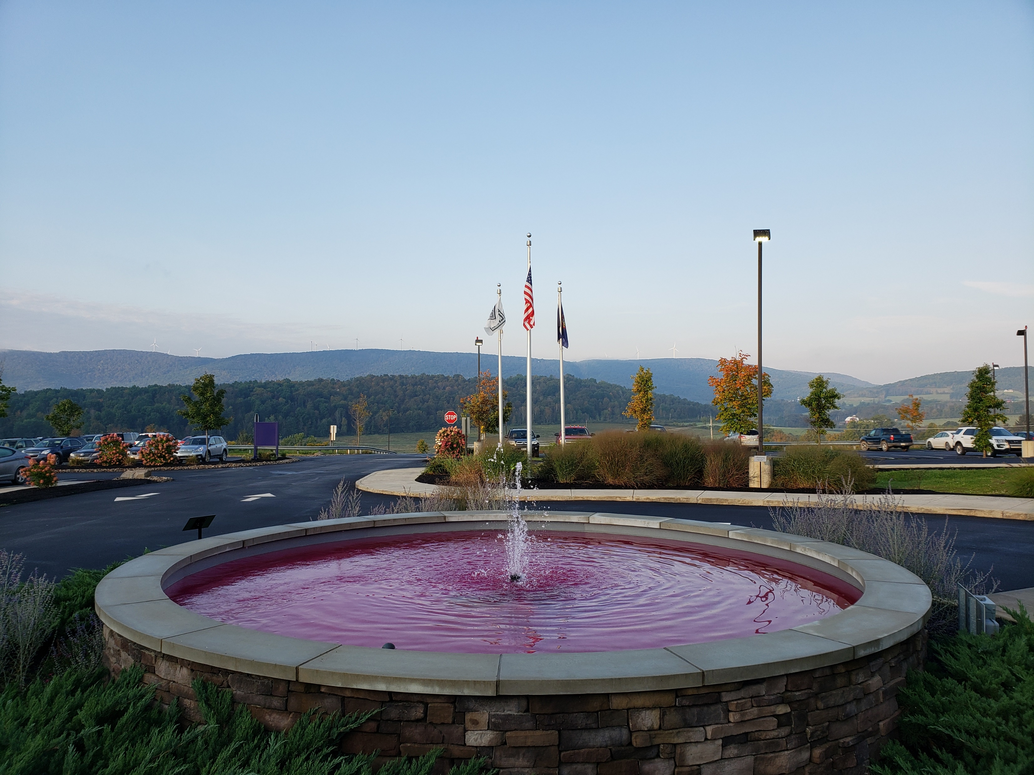
Radiology Services
  Late and early hour appointments, as well as Saturday
  Staff “in house” 24/7 for CT and x-ray
  64 slice CT scanner
  3D Mammography equipment
  MRI:
  - With canopy allowing for inpatient scans.
  - Appointments available 2 days per week

Slide 9
Rehab Services
Guthrie Troy Community Hospital offers both inpatient and outpatient services for Physical Therapy, Speech Therapy and Occupational Therapy.
Cardiac Rehab is offered on as outpatient service

Slide 10

Emergency Department Trauma Level IV
Trauma IV Certification – Surveyed August 30, 2017
- 4-year accreditation
- First CAH in Pa to receive Trauma certification
- First Level IV in Pa to receive 4-year accreditation
Re-certification (Chart Survey) August 2019
Education
- Rural Trauma Team Development Course (RTTDC)
- Advance Trauma Care for Nurses (ATCN)
- Trauma Nurse Core Course (TNCC)

Slide 11
Patient Experience
Continued focus to further improve patient experience
Patient Advocates: Social Work and Administrative team
Patient and Family Advisory Council
Rounding
Bed Side Shift Report

Slide 12
Quality
Pennsylvania Trauma Assoc.Trauma IV Certification
Pennsylvania Department of Health (PaDOH) - Every Two (2) years
Healthcare Facilities Accreditation Program (HFAP) – Every Three (3) years
Mammography, CT, Ultrasound and MRI are accredited by the American College of Radiology every 3 years
Cardiac Rehab is accredited by the American Association of Cardiovascular and Pulmonary Rehabilitation every three years.

Slide 13
In The Community
Active Member of Troy and Mansfield Area Chamber of Commerce
Refreshments and Staff provided at Troy Town Cruisers twice in 2020
Provide meeting space for local clubs and groups (Troy Booster Club, Ham Radio group)
Host high school service-learning program. Junior and Seniors seeking Healthcare related career
.

Slide 14
Community Needs Assessment
Under the Patient Protection Affordable Care Act (PPACA), every 501(c)(3) hospital is required to satisfy requirements to maintain tax exempt status. Each state-licensed hospital facility must create a Community Needs Health Assessment (CHNA) at least once every three taxable years
FY 20 Identified Community Health Needs TCH plans to address include:
Access to Mental Health Care (focus: substance abuse)
- Collaboration with CASA trinity and CONCERN
- Provider education for opiate prescribing and management
- Improve discharge planning process to increase patient access to substance abuse resources
Cancer Incidence - lung
- Promote health and wellness of employees, patients, and communities through tobacco cessation.
- Promote the importance of lung cancer screening and treatment
Obesity
- Program offered with Guthrie Bariatrician. Standardized education to primary care providers regarding ways to treat and counsel
overweight and obese patients.
- Community Garden provided by Guthrie (Sayre)

Slide 15

Questions

