Slide 1
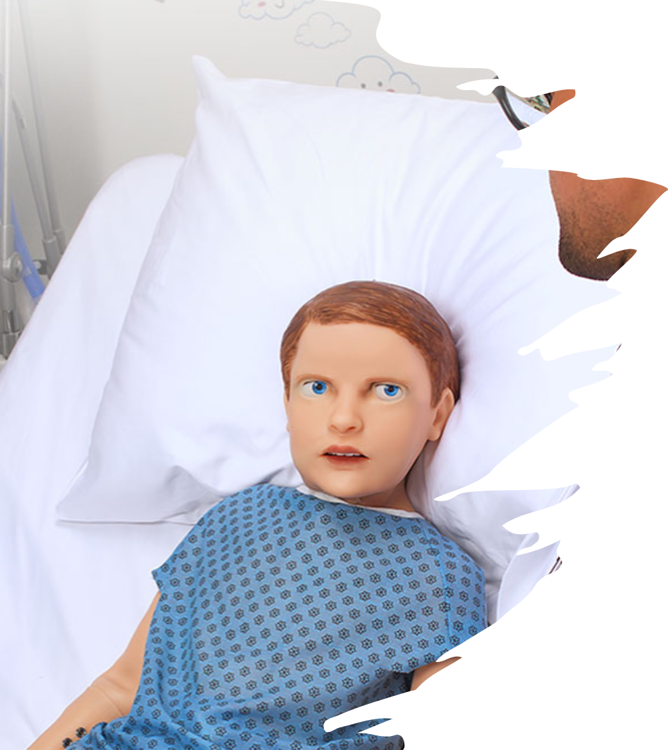
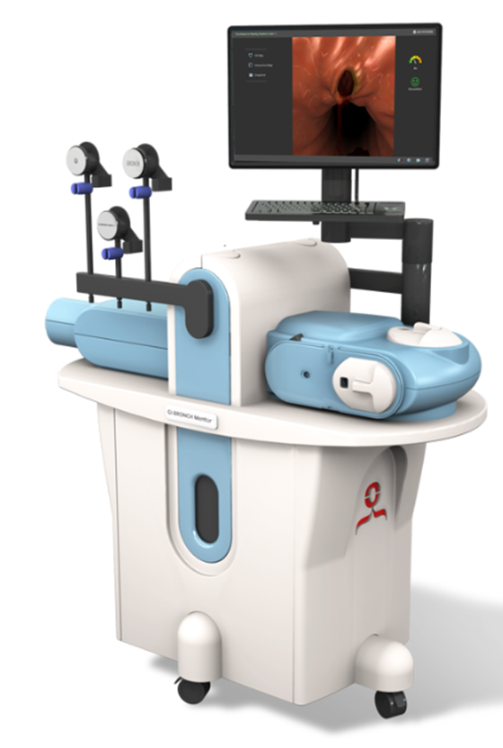
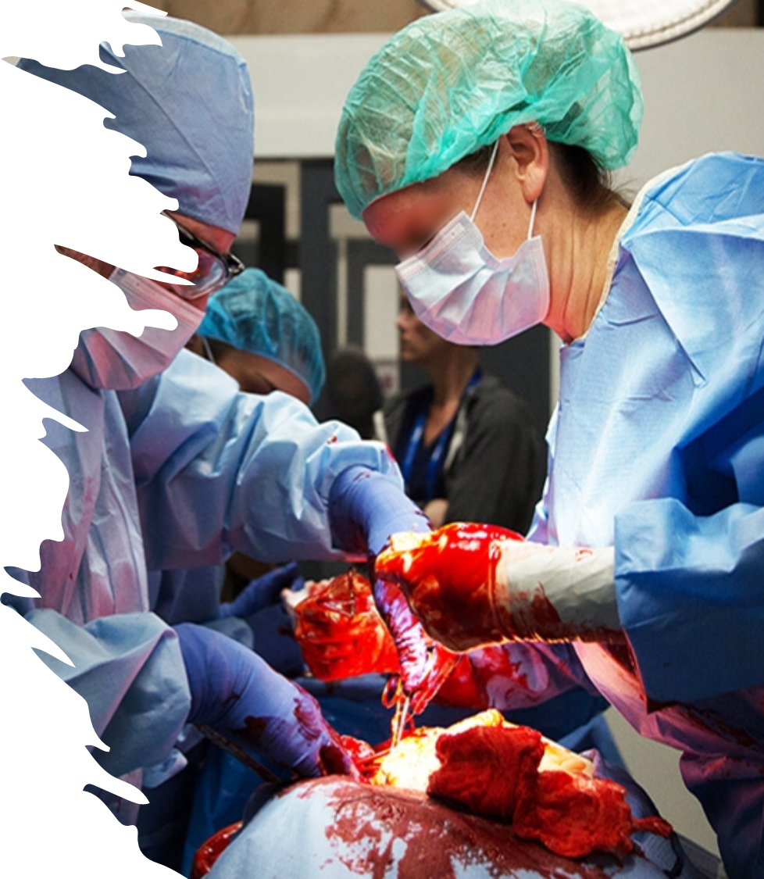
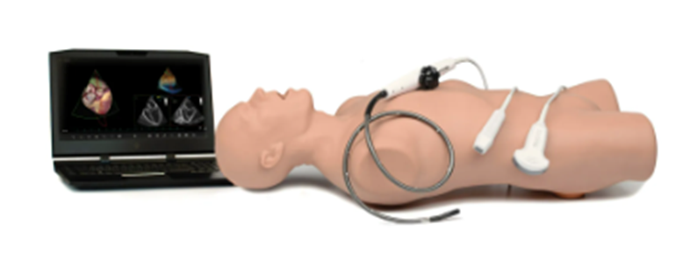
Sasi (Simulation & Advanced Skills Institute) Simulators
Updated 08.30.2023
Program Manager
570-887-6523

Slide 2
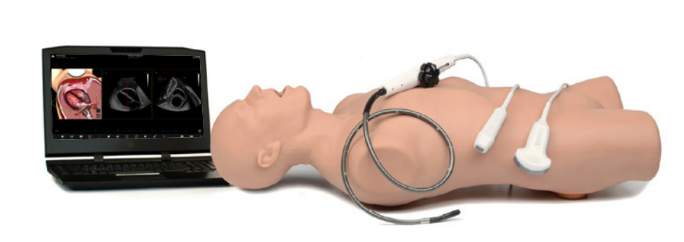
Elevate Healthcare Vimedix Ultrasound Simulation
Psychomotor skills and cognitive skills
Probe handling
Image interpretation
Diagnoses
Clinical decision-making
Available anatomy
Cardiac
TEE
Lung
Abdominal
80 Pathologies
CAE Vimedix | CAE Healthcare

Slide 3
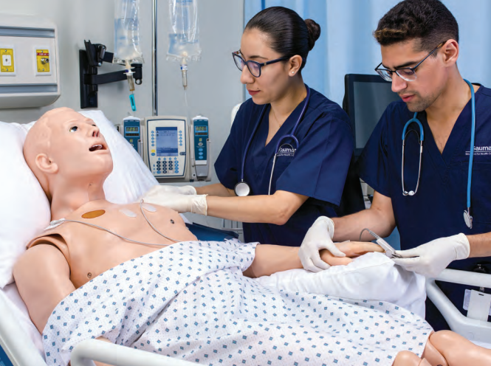
Gaumard Adult HAL® (3201)
Physiological responses
Real monitoring
Wireless and tetherless mobility
Programmable airway and lung compliance
Brochure

Slide 4
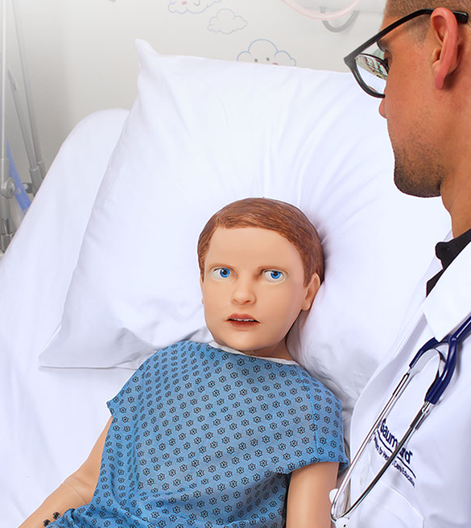
Gaumard Pediatric HAL® (S2225)
Interactive eyes and active facial expressions
Dynamic lung compliance with true ventilator support
Real patient monitor support
Surgical airway, needle decompression, and chest tube
Wireless and tetherless
Brochure

Slide 5
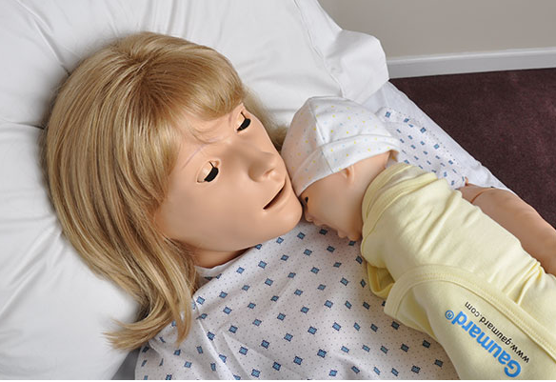
Gaumard NOELLE® (S554)
Antepartum complications
Routine and high-risk deliveries
Postpartum emergencies
Brochure

Slide 6
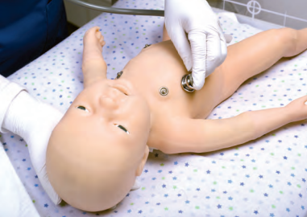
Gaumard Newborn Tory®(S2210)
Lifelike appearance and physiology
Comprehensive cardiopulmonary physiology with feedback
Fully responsive even while being carried
Brochure

Slide 7
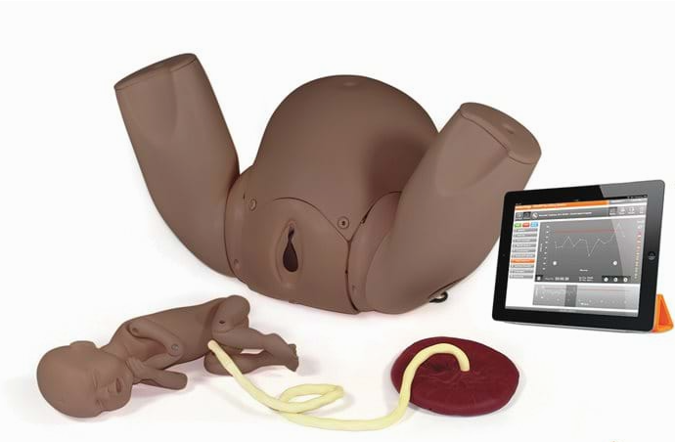
PROMPT Flex Birthing Simulator
The Advanced PROMPT Flex Birthing Simulator is an anatomically correct representation of a mother and baby. Its modular design allows for multiple training scenarios, and it forms the base for the complete PROMPT Flex range of birthing modules.
This birthing trainer offers a hybrid solution to your training needs. Quick and easy to set up straight from the box you are able to:
Use as a stand alone model for group learning
Secure to a bench top or bed for a more realistic bedside scenario to improve professional-patient communications
In addition to the functionality of the PROMPT Flex Standard model, this version of the PROMPT has a Bluetooth enabled Force Monitoring baby.
During labor there is a threshold of force that can result in brachial plexus injury during shoulder dystocia. The Force Monitoring Baby measures the force applied by trainees during drills. In conjunction with the Limbs & Things Birthing Simulator Software, instructors have the ability to record actions and interventions made, and the time to deliver the baby.
A simple meter mode in the software allows trainees valuable practice in applying force to the baby outside of the context of a scenario - enabling them to become familiar with the feel of both safe and excessive force before encountering a real obstetric emergency.
Product Link

Slide 8
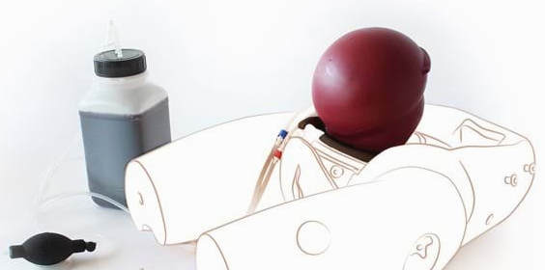
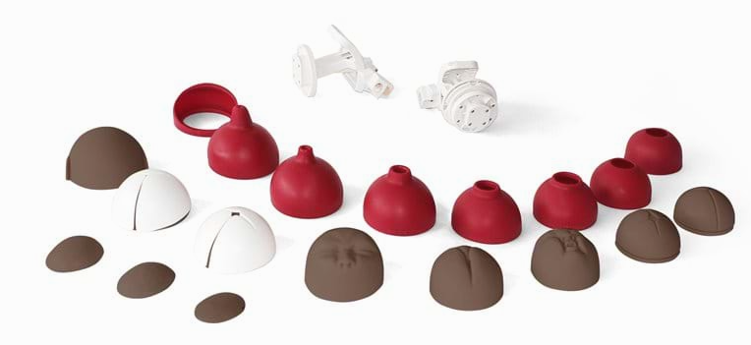
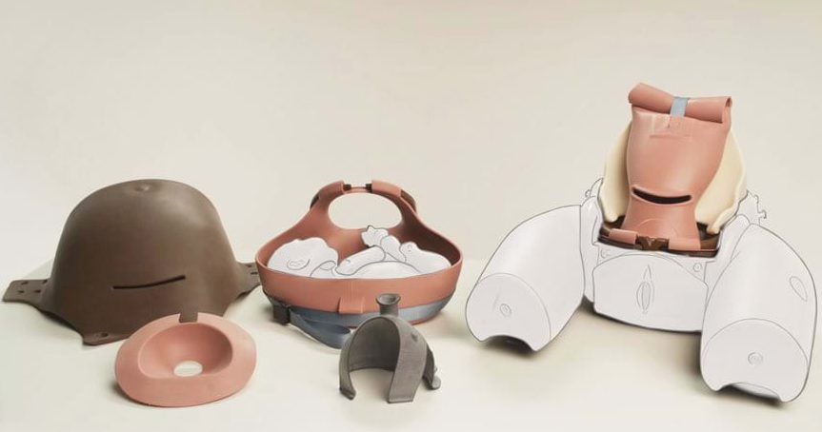
PROMPT Flex Birthing Simulator– add ons
Postpartum Hemorrhage Module
Cervical Dilation & Effacement Module
Enhanced Caesarean Section Module

Slide 9
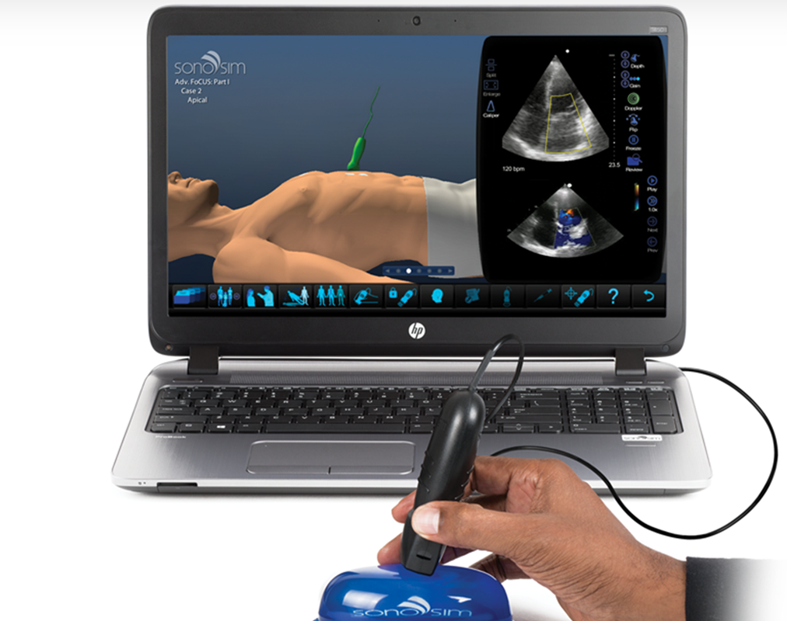
SonoSim Ultrasonography
81 courses including:
U/S Fundamentals
U/S Guided Procedures
Abdomen
Breast
Cardiac
Genitourinary
Head/neck
Musculoskeletal
Obstetrics/Gynecology
Ocular
Pediatric
Protocols
Pulmonary
Vascular
Ultrasound Education - Easy. Convenient. Effective. - SonoSim Ultrasound Training Solution
NOTE: Individual take-home training options. Ask staff for details.

Slide 10
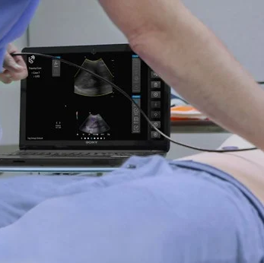
SonoSim LiveScan®
Instantly transform live volunteers and manikins into ultrasound training cases with real pathologic conditions.
SonoSim LiveScan® - Ultrasound Training

Slide 11
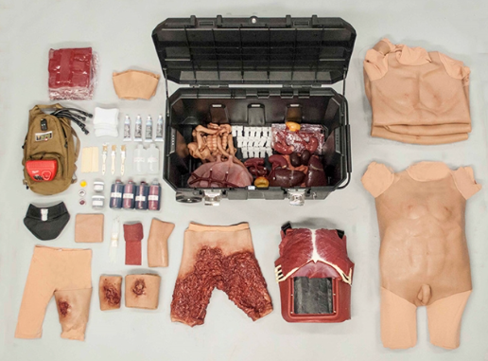
Strategic Operations- Surgical Cut Suit
Human Worn Partial Task Surgical Simulator
Extremity hemorrhage control
Iliac Arterial Hemorrhage Control
Surgical Cricothyroidotomy
Bilateral anterior and Axillary Chest Needle Thoracentesis
Bilateral Surgical Chest Tube Thoracotomy
Suturing and Stapling of skin in all locations
Foley Catheterization
External Bladder Tap
Thoracotomy and Intra-thoracic Exploratory Surgery
Laparotomy and Intra-abdominal Exploration
Suturing of Gross Organ Structures
Anastomosis and Resection
Peripheral IV Access
Surgical Cut Suit | Strategic Operations Inc. (strategic-operations.com)

Slide 12
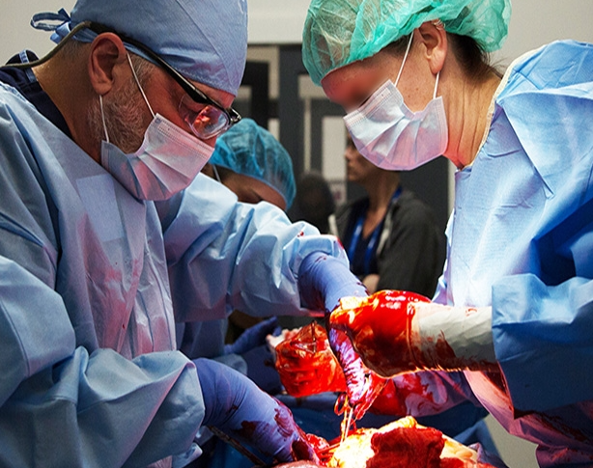
Strategic Operations- Open Surgical Simulation System
Chest Injury Pattern Capabilities
Pneumothorax
Hemothorax
Pericardial tamponade
Right ventricular laceration
Left lung lower lobe bleeding injury
Abdominal Injury Pattern Capabilities
Hemoperitoneum
Grade IV liver injury
Grade IV Splenic injury
Grade IV left renal injury
Zone II expanding hematoma
Left external iliac artery injury
Inferior vena cava injury
Small bowel injury
Colon injury
Ureteral injury
Open Surgical Simulation System (OS3) | Strategic Operations Inc. (strategic-operations.com)

Slide 13
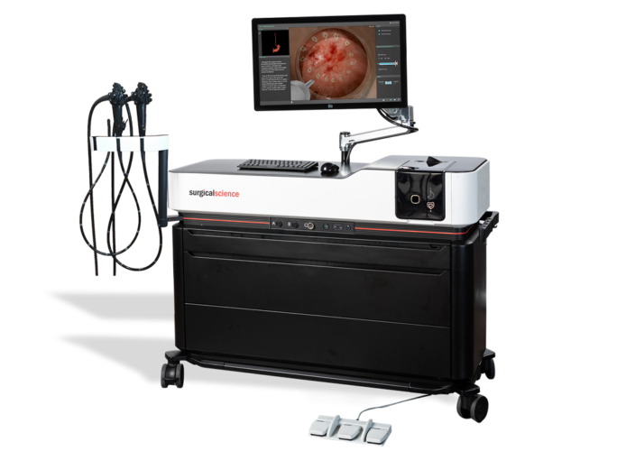
Surgical Science GI Endoscopy/Bronchoscopy
Exclusive simulator for SAGES FES testing, as required by the ABS for all general surgery residency graduates in North America
Provides an excellent environment for acquiring essential skills, practicing clinical procedures in a safe and realistic manner, and demonstrating one’s proficiency
Comes with extensive curricula from basic diagnostics, through complex anatomies and emergency cases to challenging procedures
Educational environment includes aids such as 3D anatomical map, pain indicator and virtual instructor providing dynamic feedback as to trainee’s performance and patient safety
The most evidence-based simulator for GI endoscopy with over 60 studies including established predictive value
GI Mentor | Simbionix

Slide 14
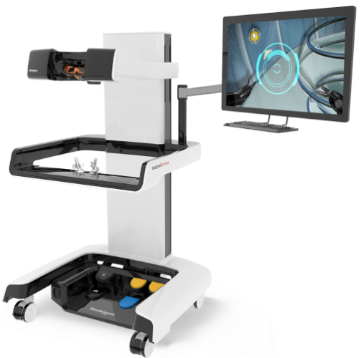
Surgical Science RobotiX Mentor
Highly realistic graphics of human anatomy and simulation of tissue response to instruments
Adheres to the skills, tasks, errors and metrics of a comprehensive robotic surgery training curriculum
Interactive task and procedural guidance
Complication management: simulation of errors and bleedings
Fully integrated online for efficient curriculum management
Setup options suitable for individual and team training
Tutorials: videos of experts performing tasks and procedures on the simulator along with videos of real procedures
Includes performance feedback reports, and customization of curriculum and benchmarks
RobotiX | Surgical Science

Slide 15
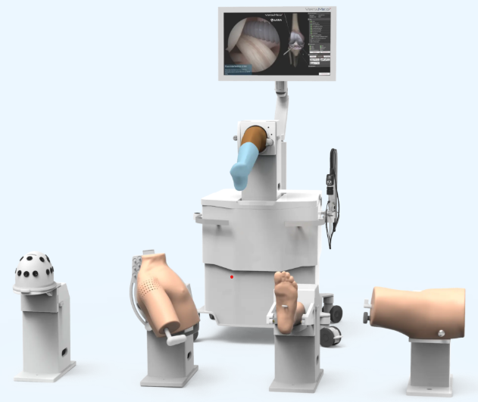
VirtaMed ArthroS™
Fundamentals of Arthroscopy Surgery (FAST)
Image centering
Horizon control
Telescoping
Triangulation
Use of different optics
VirtaMed ArthroS™ Knee
Basics of knee arthroscopy
Complete diagnostic arthroscopies
VirtaMed ArthroS™ Shoulder
Shoulder navigation
15-point shoulder exam
Therapeutic cases
VirtaMed | ArthroS™ simulator for knee, shoulder, hip and ankle arthroscopy training

Slide 16
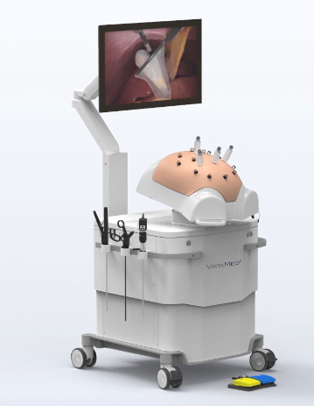
VirtaMed LaproS™
LaproS™ Essential Skills
LaproS™ General Surgery
VirtaMed | LaproS™ innovative laparoscopy simulation

Slide 17
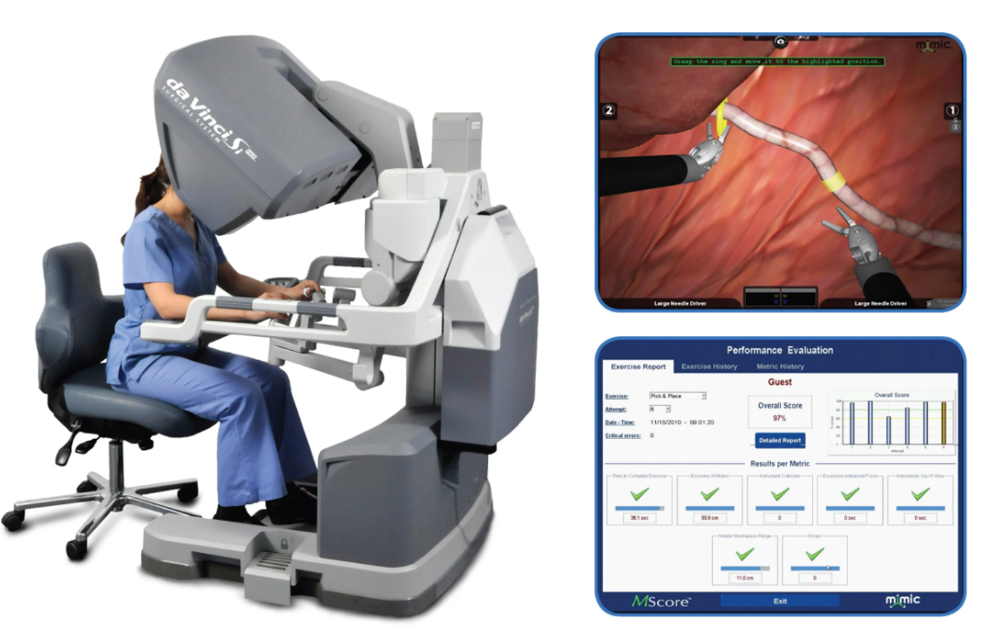
Da Vinci SimNow
library of realistic simulations for practice of system skills, procedure training exercises, and virtual reality experiences
train on da Vinci system
performance measurement and customizable curricula to manage skills development
*4th floor OR location

