Slide 1
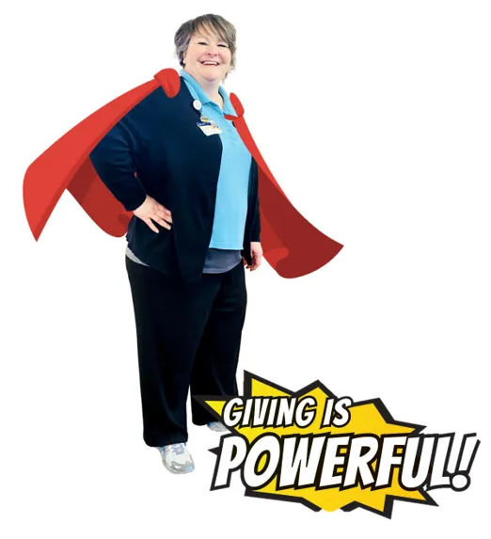
2023 Caregiver Campaign Caregivers Unite! Your Gift is Powerful
What is the Caregiver Campaign?
The 2023 Caregiver Campaign gives caregivers the opportunity to support our patients and colleagues by making a gift to Guthrie.
“Giving is contagious; whether it’s a smile, or a meal, or a monetary gift, no matter how small. Giving inspires giving. No matter how much or how little you can give, you have the power to touch the life of another person and affect them in ways you may never completely know. One person CAN make a difference. I don’t know about you, but that possibility gives me great joy.”- Dawn Jayne, Supervisor, Courtesy Services, The Guthrie Clinic

Slide 2
2023 Caregiver Campaign Caregivers Unite! Your Gift is Powerful
How Can I Get Involved?
Become a CareGIVER and make a donation to the campaign!
It’s as easy as 1, 2, 3, when you donate online via payroll deduction. Once you make donation via payroll deduction, your gift will automatically roll over year after year.
Join our team as a Department Captain and Campaign Champion!
Department Captains champion the campaign and ensure each area of the organization is hearing about the important message that giving is powerful. We are encouraging managers to identify emerging leaders from their departments who would be willing to represent their department as a captain.
We are confident that with your support, the 2023 Caregiver Campaign will continue to make a meaningful difference in the lives of our patients, our fellow employees, and our community.

Slide 3
2023 Caregiver Campaign Caregivers Unite! Your Gift is Powerful
What Does a Department Captain and Campaign Champion Do?
As a Champion, you spread the word, answer questions and encourage participation in the 2023 Caregiver Campaign. Here’s the info you need to know!
Share Campaign information with your department
Put up posters in your break room
Share campaign info at your staff meeting (or invite a member of Resource Development to answer questions).
Host a kick-off with your team.
Encourage participation – Throughout March, you’ll receive a series of campaign emails from your manager that include information, donation links, highlights of the incentives and prizes. You can forward these emails to your team with a personal note reminding them to participate!
Be a resource - Answer questions about how to give and what areas people can give at Guthrie.

Slide 4
2023 Caregiver Campaign Caregivers Unite! Your Gift is Powerful
Champion Timeline and To Do!
Week of February 27: Keep an eye out for your campaign champion supplies from your manager! Display campaign posters and table tents in areas frequented by caregivers.
Paper pledge forms
Frequently asked questions about the campaign
Promotional materials to share in breakrooms
Virtual took kit
March 3: Caregiver campaign kick-off and Q&A session Teams call!
Week of March 6: Campaign in full swing! All caregivers will receive postcard and email reminders, March 6 through March 27. When you receive these items, it’s a great time to remind your colleagues to join the campaign.
Weeks of March 6 – March 27: Encourage your colleagues to join the campaign!
Share the campaign info at your team meeting or invite us to share the info
Share your own story or why you give
Answer any questions and thank your colleagues for their participation
April: Look out for your incentive thank you gifts after the campaign!

Slide 5
2023 Caregiver Campaign Caregivers Unite! Your Gift is Powerful
What You Need To Know!
Campaign runs March 6 through March 27
Payroll deductions will start on April 8 and will run for 26 or 12 pay periods based on your pay schedule.
Printable pledge cards will be sent via email to every Guthrie employee with the campaign kick-off email!
Employees are encouraged to donate online at www.Guthrie.org/hero.
We are working to make giving easier for you, so if you made a 2022 campaign gift via payroll deduction it will automatically renew in 2023! That's right -- you don't need to turn in a form or respond online. You, and your gift, are on a roll by rolling over!

Slide 6
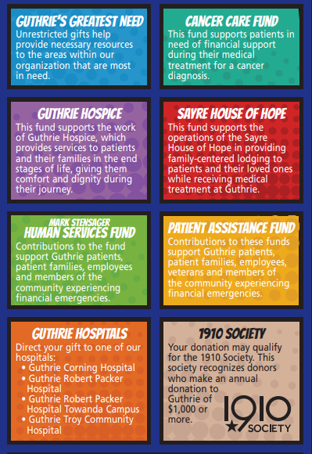
2023 Caregiver Campaign Caregivers Unite! Your Gift is Powerful
How Do My Donations Help?
In 2022, hundreds of employees gave more than $200,000 in support of the fund, program, or facility they felt most passionate about. These generous donations were used to support some of our most worthy causes such as Sayre House of Hope, Hospice, Cortland Memorial Foundation, and patient assistance funds like The Mark Stensager Human Services Fund. Your donations can also support important services not featured here such as Medical Education and Nursing Professional Development.

Slide 7
2023 Caregiver Campaign FAQ’s
Where does my money go? – 100% of your donated dollars go toward the fund, program, or facility intended by the donor. Each fund is unique and directly benefits our patients, fellow employees, and our community. These funds can help with a broad range of needs.
Charitable dollars can provide gas cards for those patients traveling to Guthrie for treatment.
Families can stay in the comfortable home-like atmosphere of the House of Hope, while their loved one is receiving life-saving care at Guthrie.
State of the art equipment can be purchased to keep Guthrie at the forefront of healthcare.
Why does Guthrie need my money? – As a not-for-profit organization, the donations we receive every year enable us to support numerous programs and services throughout the Guthrie footprint and help to ensure that we are able to provide the highest quality of service to the residents of the communities we serve.

Slide 8
2023 Caregiver Campaign FAQ’s
What if I can’t donate very much? Does a small donation make a difference? Absolutely, every dollar helps! A donation of $2.00 a pay period can pay for a family to stay one night at the House of Hope
I donated to the United Way. Isn’t this the same thing? The United Way is a separate not-for-profit organization that Guthrie strongly supports. The United Way and Guthrie work together to make our community a better place. The United Way works directly with our community to provide necessary programs to make our regions a better place to live. Giving to the charitable funds at Guthrie, helps our patients receive the best care possible, it helps make our hospitals and clinics a better place to work, and it helps our community become a better place to live.
I want to donate, but I don’t know all the options available to me. There is a list of Guthrie giving options available on your pledge form and online. If you are curious where you can designate your dollars contact Resource Development at 570-887-4420 or Resource _Development@guthrie.org.

Slide 9
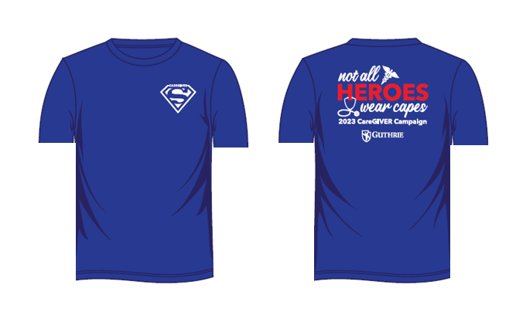
2023 Caregiver Campaign Caregivers Unite! Your Gift is Powerful
2023 Caregiver Campaign Participation Prizes!
Premium deluxe gift packages
Premium parking at designated locations
Custom t-shirt that you can wear to work on designated days with a donation of $260 or more!

Slide 10
2023 Caregiver Campaign Caregivers Unite! Your Gift is Powerful
We are asking all caregivers to join forces, make a gift, and make a powerful difference in the lives of our patients, our colleagues, and the communities we serve.

